Slide 1

Green University of Bangladesh
OFFICE NETWORK SETUP
Using Cisco Packet Tracer

Slide 2



MEET OUR GROUP
Teacher
Student
Student
Muhaimen Khan
Lecturer
Dept. of CSE
Saifulla Tanim
222002014
Mim Akter
222002104

Slide 3

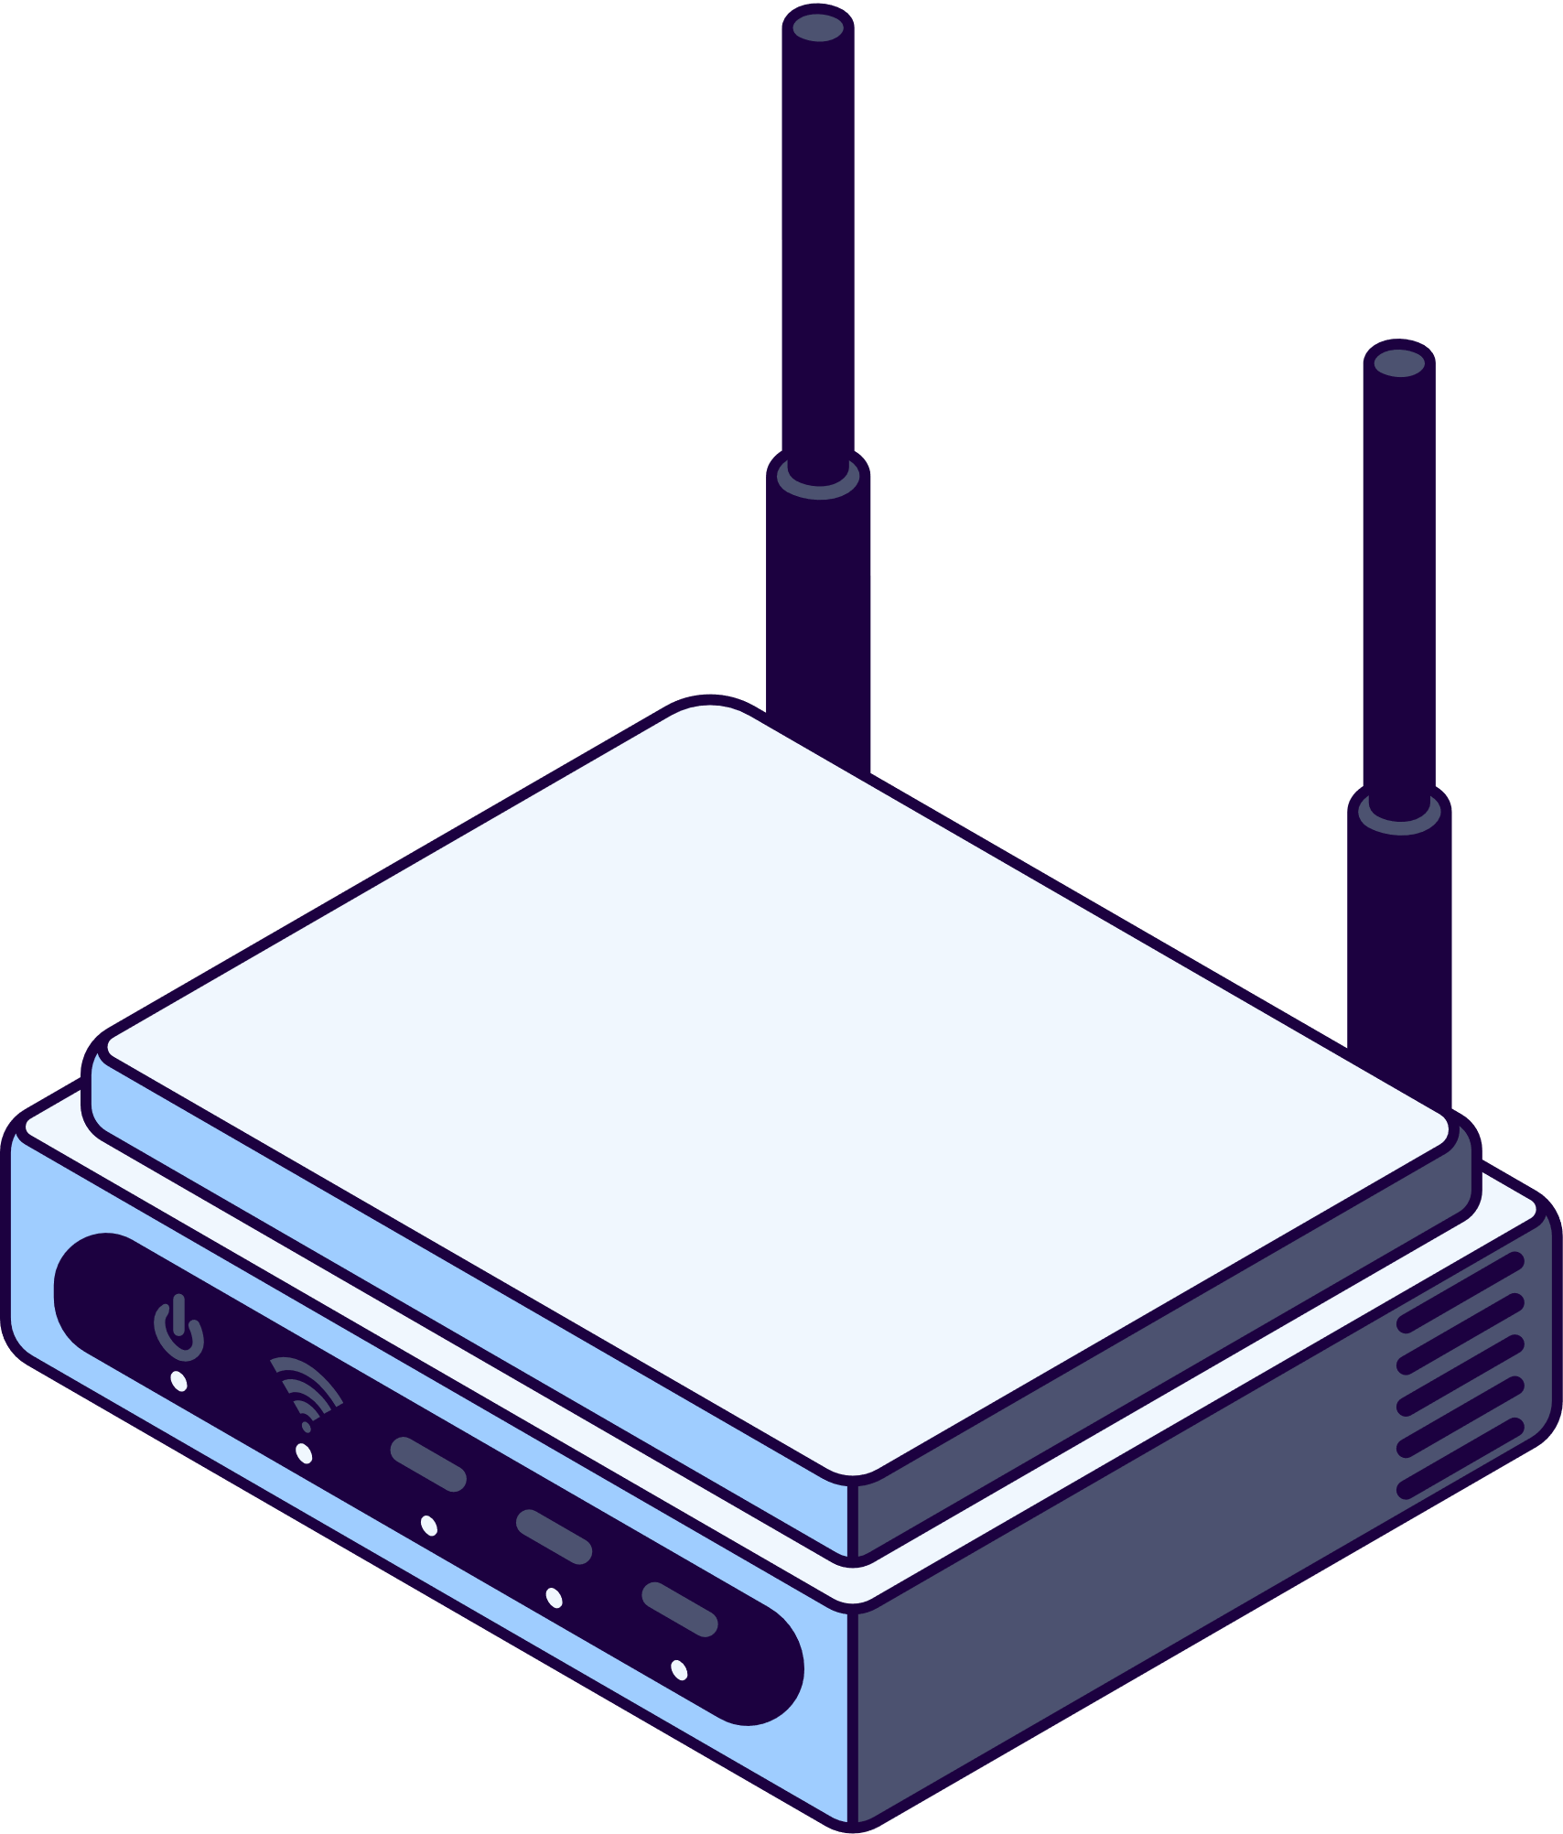




TABLE OF CONTENTS
Introduction
Objectives
Network Components
Configuration Steps
Challenges and Solutions
Conclusion

Slide 4

INTRODUCTION
This project simulates a small office network with four departments using Cisco Packet Tracer. It demonstrates device setup, IP configuration, and static routing to ensure efficient communication and connectivity

Slide 5
OBJECTIVES
Design and configure a small office network.
Implement IP addressing and routing.
Ensure seamless communication and connectivity.

Slide 6



NETWORK COMPONENTS
Connectivity: Devices are interconnected using switches and routers.
Devices: PCs, switches, printers, servers, laptops, and routers.
IP Addressing: Each department has its unique IP address range.
Network Segmentation: Ensures efficient communication and traffic management.

Slide 7
Configuration Steps
End Devices
Assign IP addresses
subnet masks
default gateways
Switch Configuration
Connect devices
Enable VLANs
Ensure port connectivity
Router Config
Assign IPs
Set static routing
Enable dept. communication
Network Testing
Test local devices
Verify inter-department l
Troubleshoot routing

Slide 8

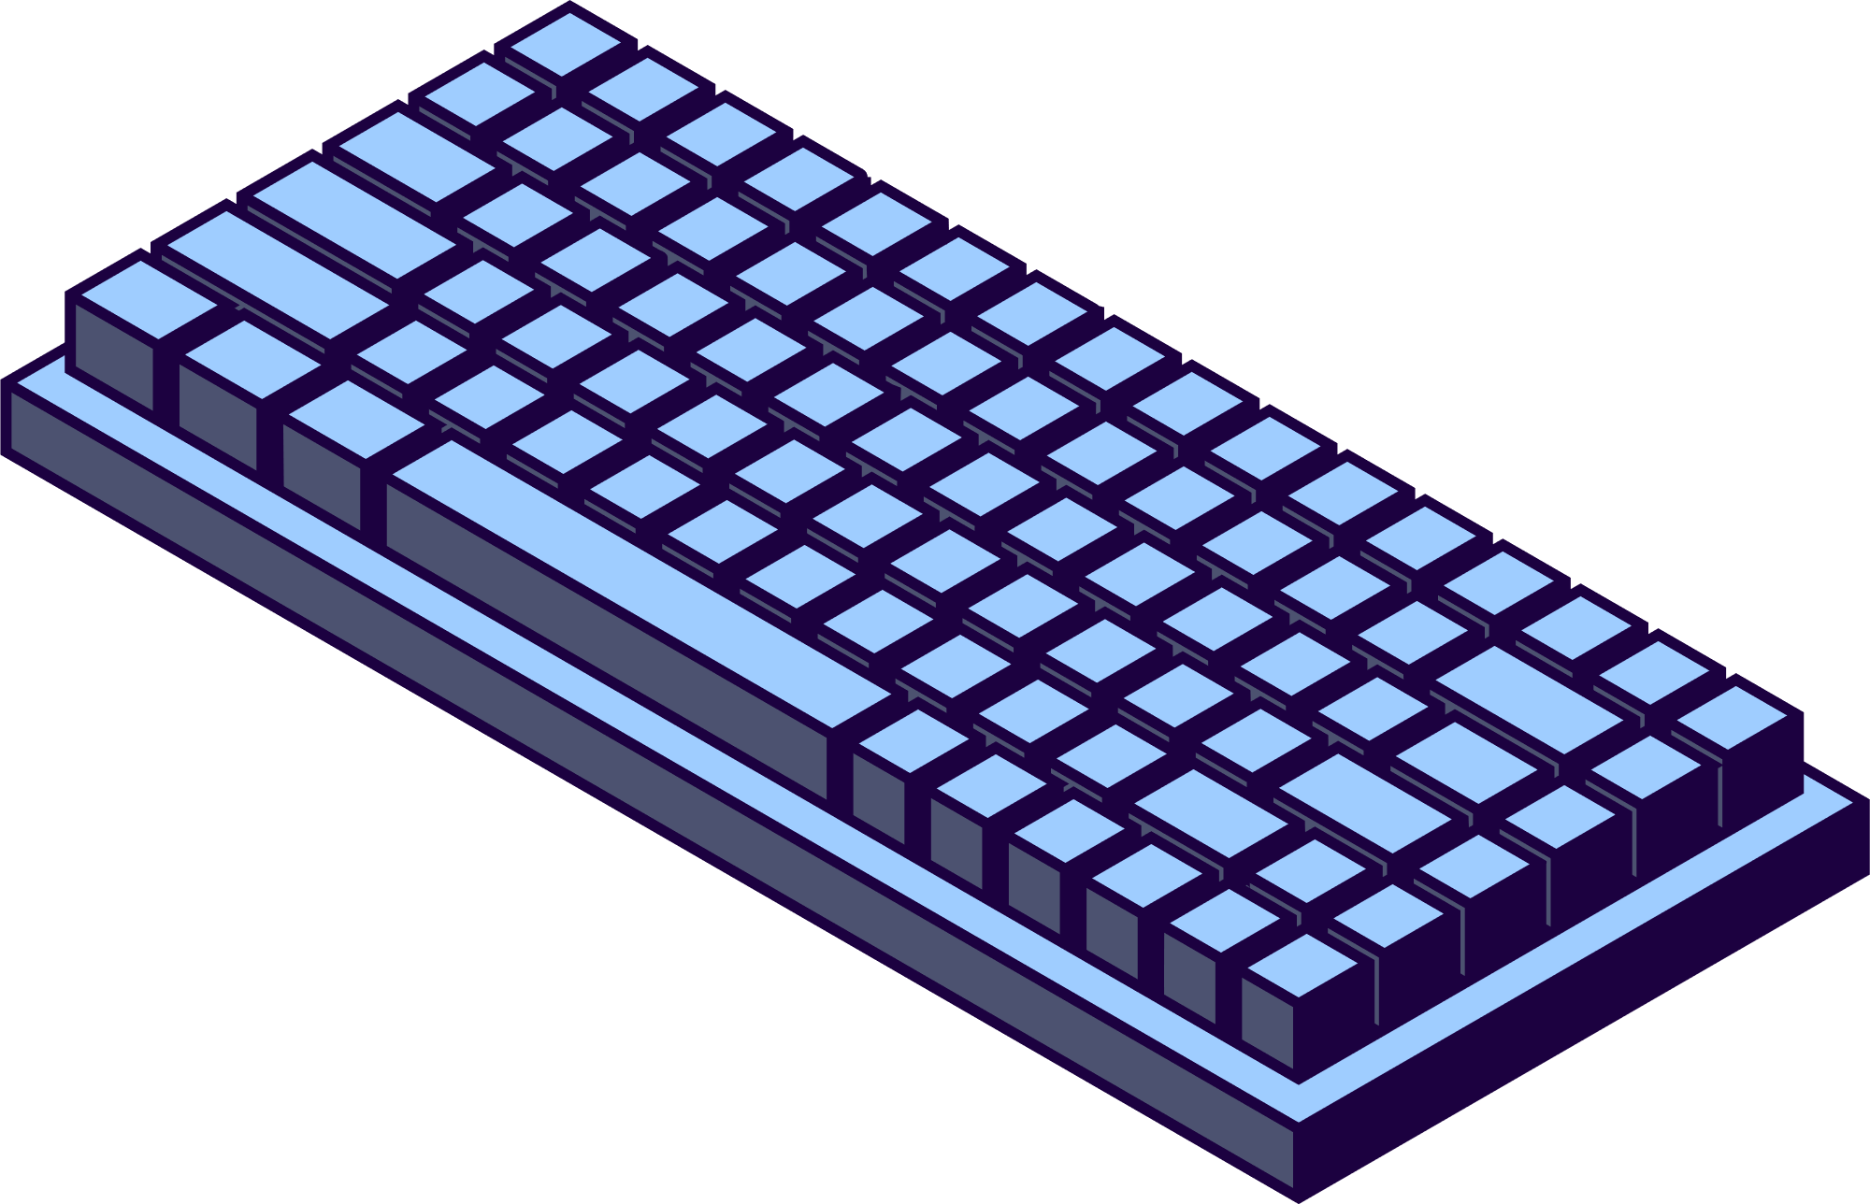
Challenges:
Incorrect IP addressing causing network conflicts.
Misconfigured static routes leading to connectivity issues.
Device communication failures due to inactive ports.
Inefficient traffic management across networks.
CHALLENGES AND SOLUTIONS
Solutions:
Segment with subnetting or VLANs.
Verify routing tables and network IDs.
Check switch and router port activity.
Assign accurate IP addresses.

Slide 9
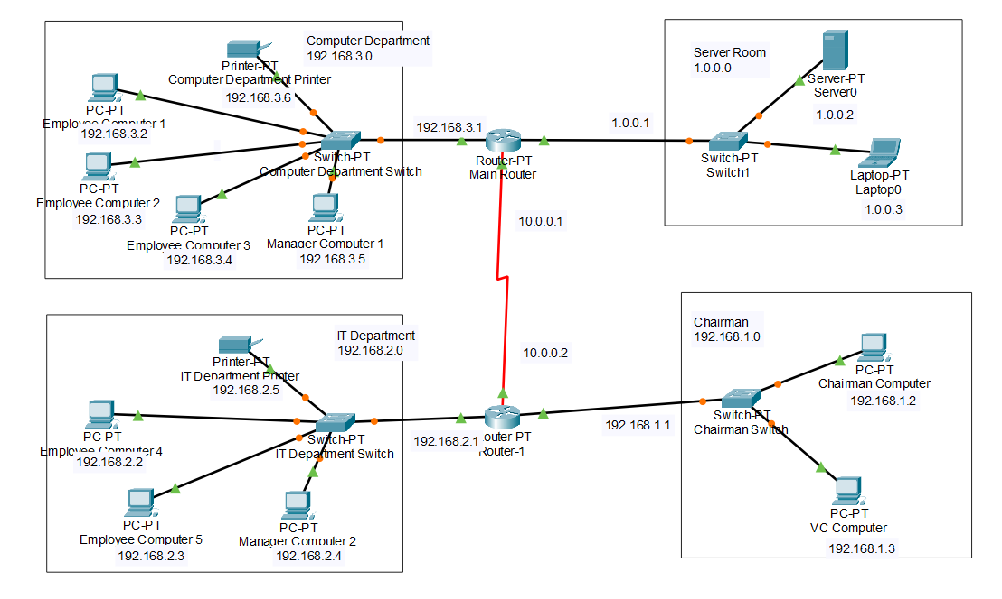
PROJECT INTERFACE

Slide 10
CONCLUSION
In conclusion, we've covered the essential steps for setting up a small office network using Cisco Packet Tracer. Key takeaways include the importance of thoughtful design, meticulous configuration, and thorough testing to ensure a robust and efficient network. This process is crucial for reliable interconnectivity in any office environment.

Slide 11


